Slide 1


Portfolio 02
How to create a surveillance video with object detection. Programming the eazy way

Slide 2
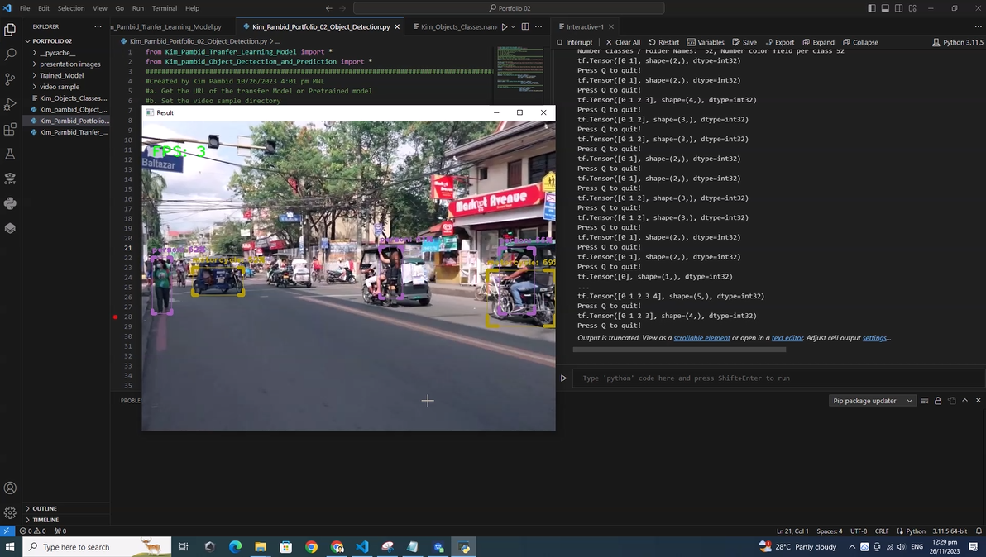
The Results
(separated post for video)

Slide 3

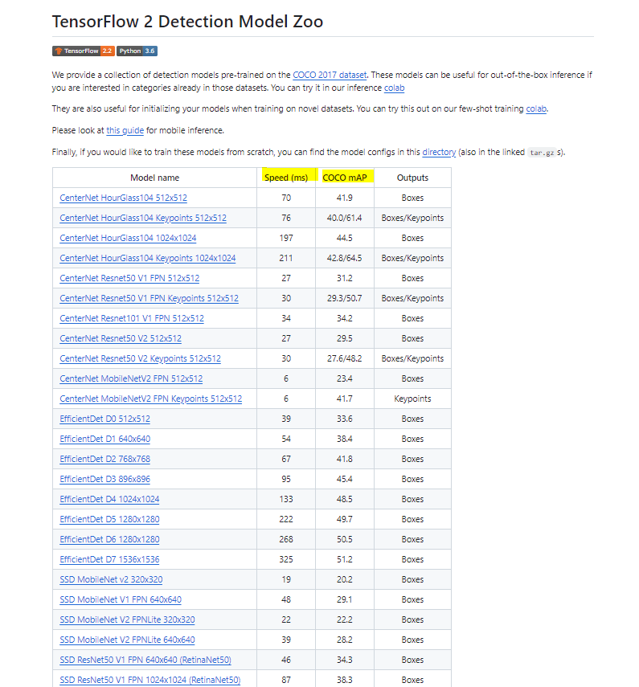
Brief Explanation:
In this project we use pre-trained model which called transfer learning.
For aiming for high accuracy and quick results, we download the model from this site: https://github.com/tensorflow/models/blob/master/research/object_detection/g3doc/tf2_detection_zoo.md
Note:
a. The better the accuracy, the slower the prediction (especially without GPU)
b. No image to train and test (but there an option for starting from scratch)

Slide 4
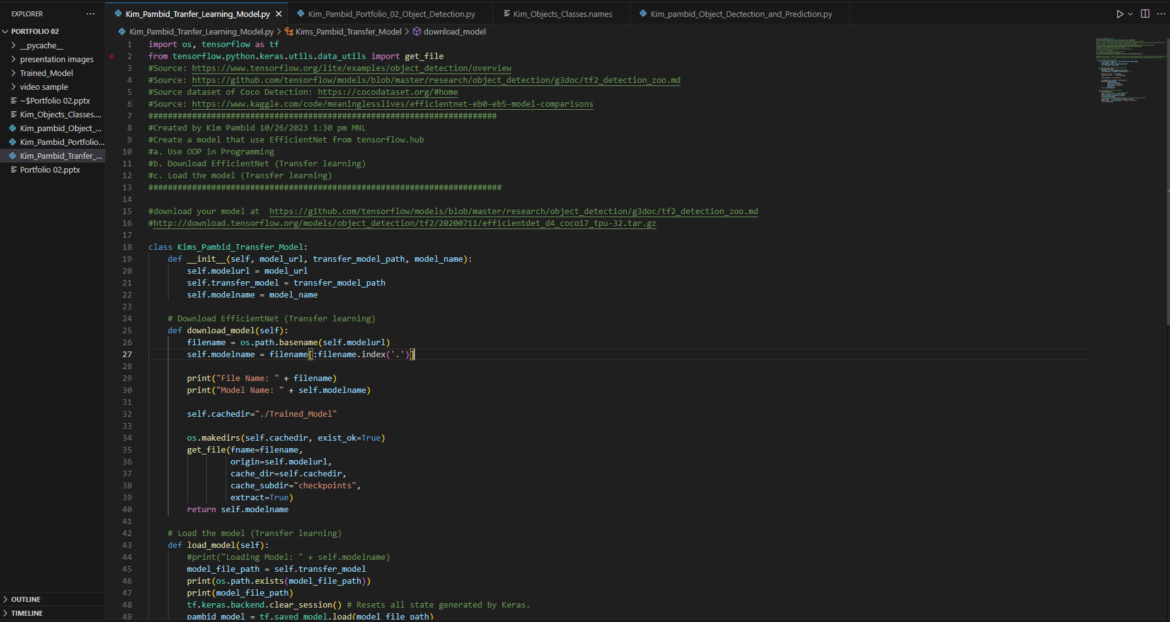
Follow the box!!

Slide 5
What model are we using??

Slide 6
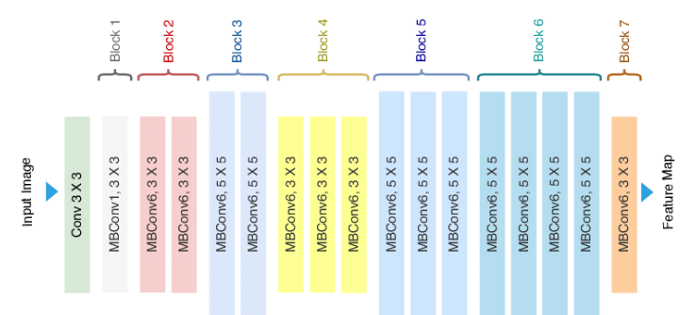
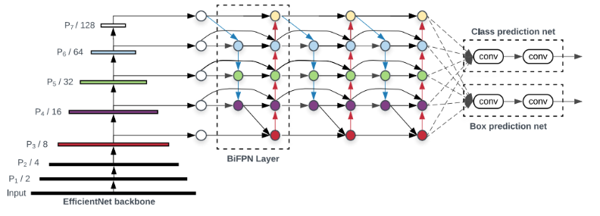
EfficientDet Model :
EfficientDet is a state-of-the-art object detection model for real-time object detection. It back bone was orignally came from EfficientNet.
EfficientNet: EfficientNet is a CNN that uses a scaling method called compound scaling that aims to improve the efficiency of an existing ConvNet based on the available resources (memory and FLOPS). The resulted networks proved to be both more efficient and more performant than many state of the art networks.
EfficientNet architecture EfficientDet architecture
References:
https://iq.opengenus.org/efficientnet/
https://amaarora.github.io/posts/2021-01-13-efficientdet-pytorch.html

Slide 7
Creating bounding boxes and predicting the video...

Slide 8
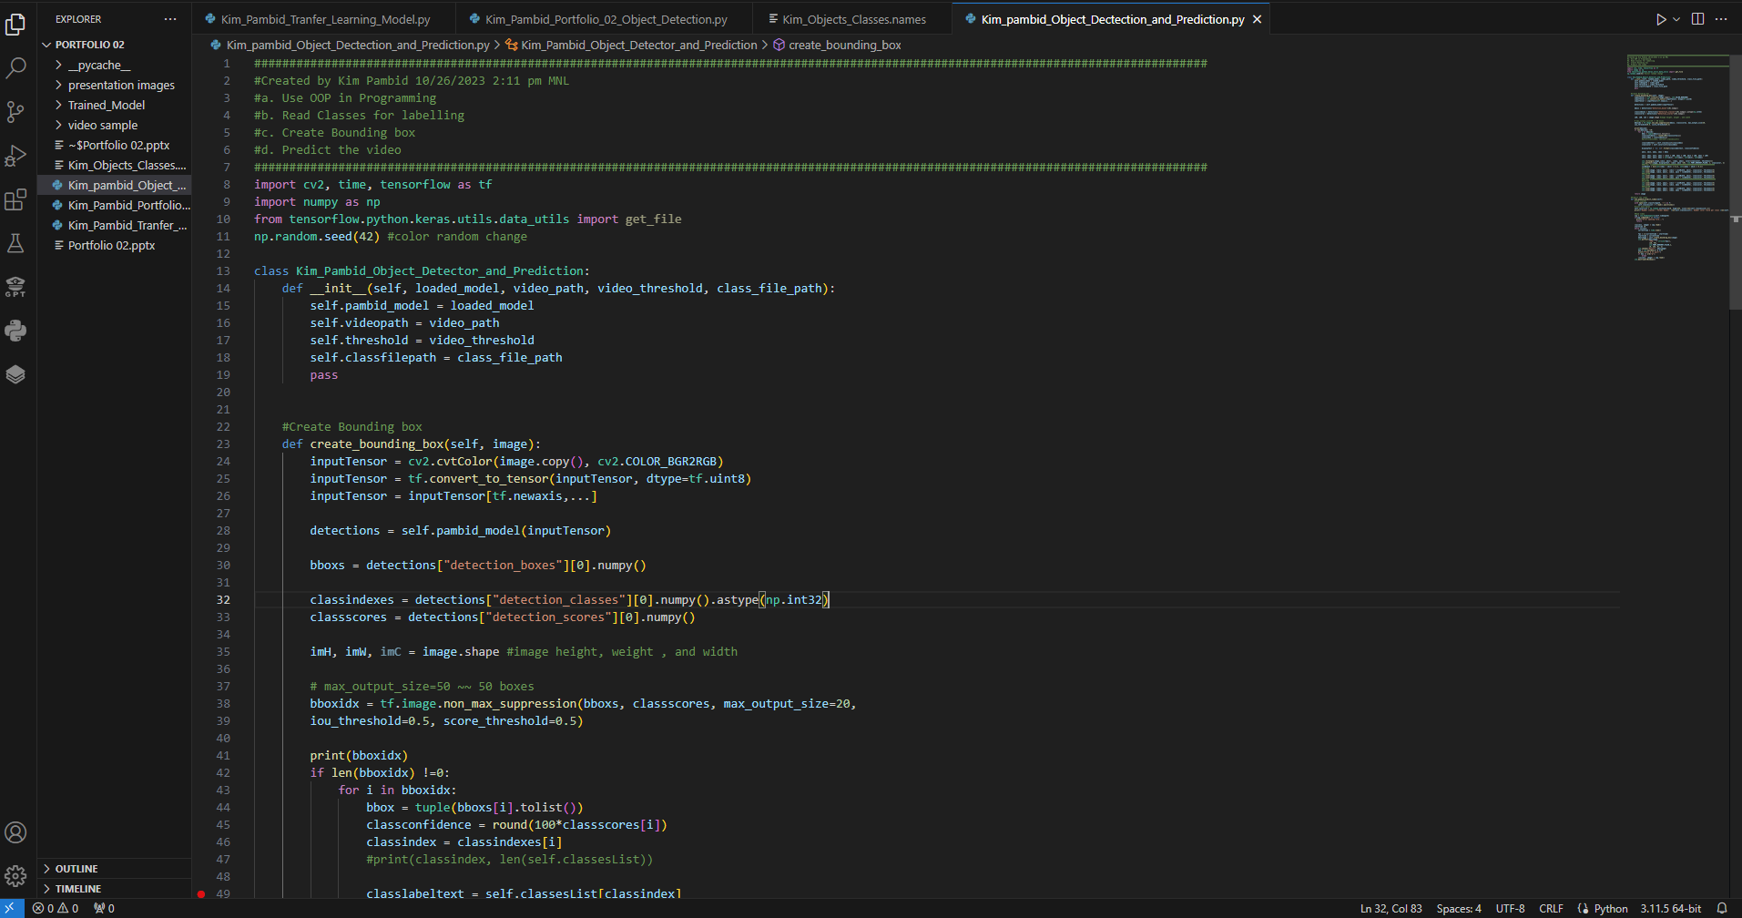
For Bounding Box use CV2 and Numpy
CV2 is a powerful library for working with images in Python. It is the most commonly used in loading and display, image manipulation, and image filtering.
Numpy is known as the fast and versatile de-facto standards of array or matrix computing. The core of NumPy is well-optimized C code.

Slide 9
Activating the project!

Slide 10
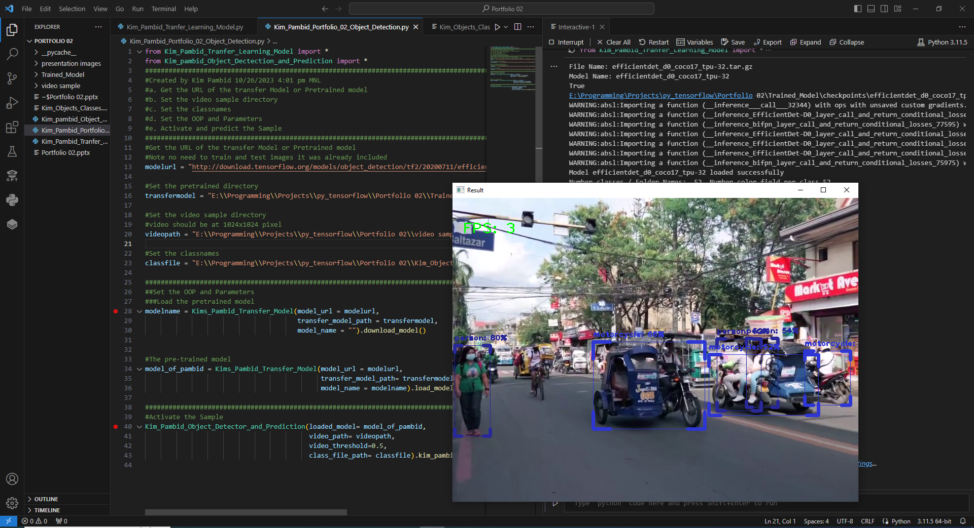
Follow the box!!

Slide 11
That All : )
Thanks for viewing
Next is Numpy
or convert image to Numpy

